Slide 1
CS 157A: Final Project
By- Chandramouli Iyer, Atishay Jain, Vishwesh Mashruwala, Devam Sheth, Het Tikawala

Slide 2
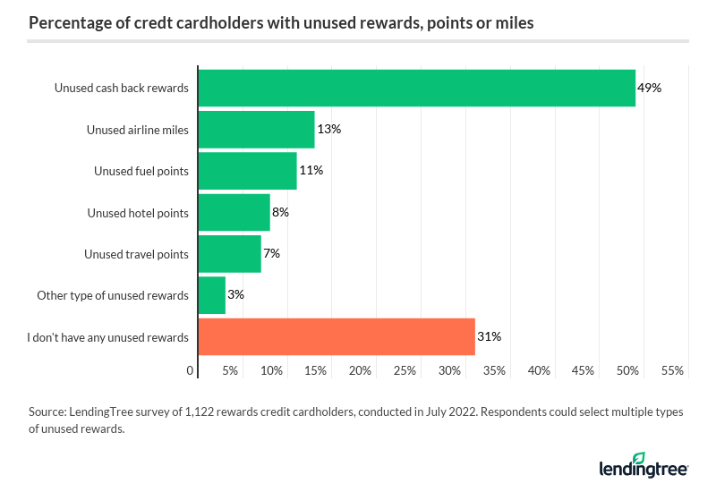
Incentive Usage
Approximately 572 million credit card accounts in the US. Overall, more than 1 billion credit cards [1].
87% of cardholders have at least one credit card that allows them to earn rewards [2].
Almost 70% unused cashback, rewards, points, or miles [2].
Approximately 197 million people!

Slide 3

The Problem: Unclaimed Cashback
A significant number of consumers fail to claim cashback offers during transactions, missing out on potential savings.
Impact on Consumers: Lack of awareness or complex claiming processes lead to untapped financial benefits.
55% of the card holders in the US do not take advantage of cashback on their cards

Slide 4

Plutus: Application Overview
Main Goal: To automate the process of identifying and notifying users about relevant cashback offers, integrated with their financial credentials.
User-Friendly Interface: Features a responsive, intuitive React-based interface for seamless user interaction.
Real-time Data Processing: Utilizes a robust backend with Spring Boot for real-time data handling and notifications.
Secure and Efficient: Designed to ensure data security and efficient operation within a complex database system.

Slide 5
Functional Requirements
User-Centric Design: Plutus features a user-friendly interface that simplifies the tracking and claiming of cashback rewards.
Notifications: Users receive instant notifications about cashback opportunities directly linked to their transactions, ensuring they never miss out on savings.
Search Offers: Users can search for their offer from a huge list of offers.
Secure and Reliable: Plutus ensures the security of user data through robust authentication protocols and secure data handling practices.
Ease of Access: Accessible across various devices, providing a seamless experience whether on mobile or desktop.

Slide 6



Application Architecture
Frontend: React: Utilizes React for dynamic, responsive user interfaces. Implements SPA for seamless user interactions.
Backend: Spring Boot: Handles complex business logic and data processing. Facilitates RESTful API communication.
Database: MySQL: Robust MySQL database ensures efficient data management and real-time transaction processing.
Security Measures: Incorporates Spring Security for authentication and secure data handling.
API Communication: Uses JSON over REST for efficient, secure data exchanges between the frontend and backend.

Slide 7
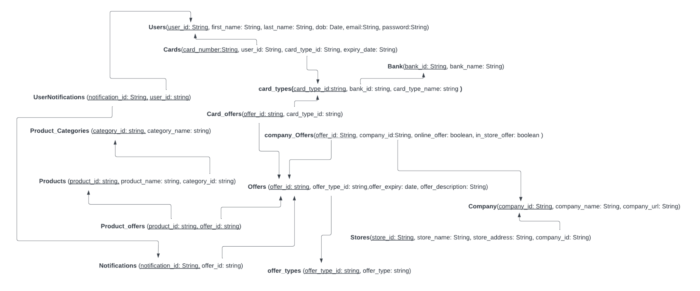
Database Schema

Slide 8
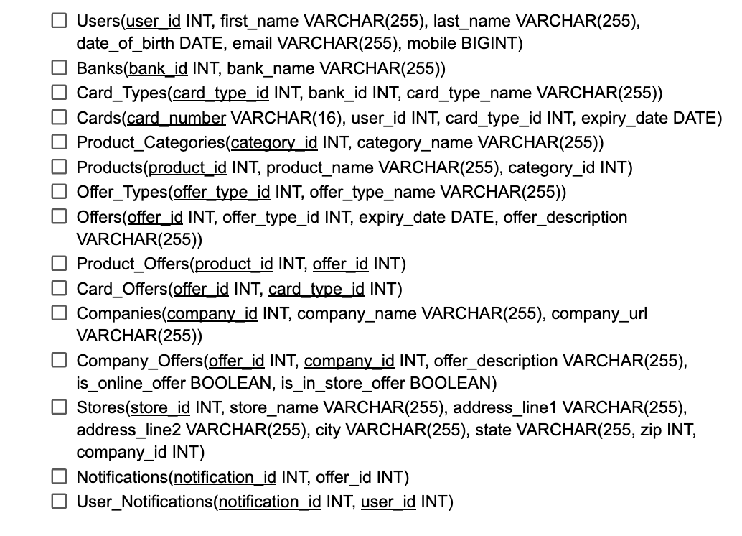
Major Design Decisions
Unified Offers Table: Centralized management of diverse offers to enhance scalability and maintenance.
Separate User Notifications: Personalized notification management to ensure relevance and efficiency.
Choice of Technology Stack: Opted for React and Spring Boot for their robustness and community support.
Data Handling Optimization: Implemented advanced SQL queries and indexing for performance efficiency.
Normalization and Indexing: Normalized tables and indexed appropriate columns
Security Integration: Incorporated comprehensive security features to protect user data and transactions.

Slide 9

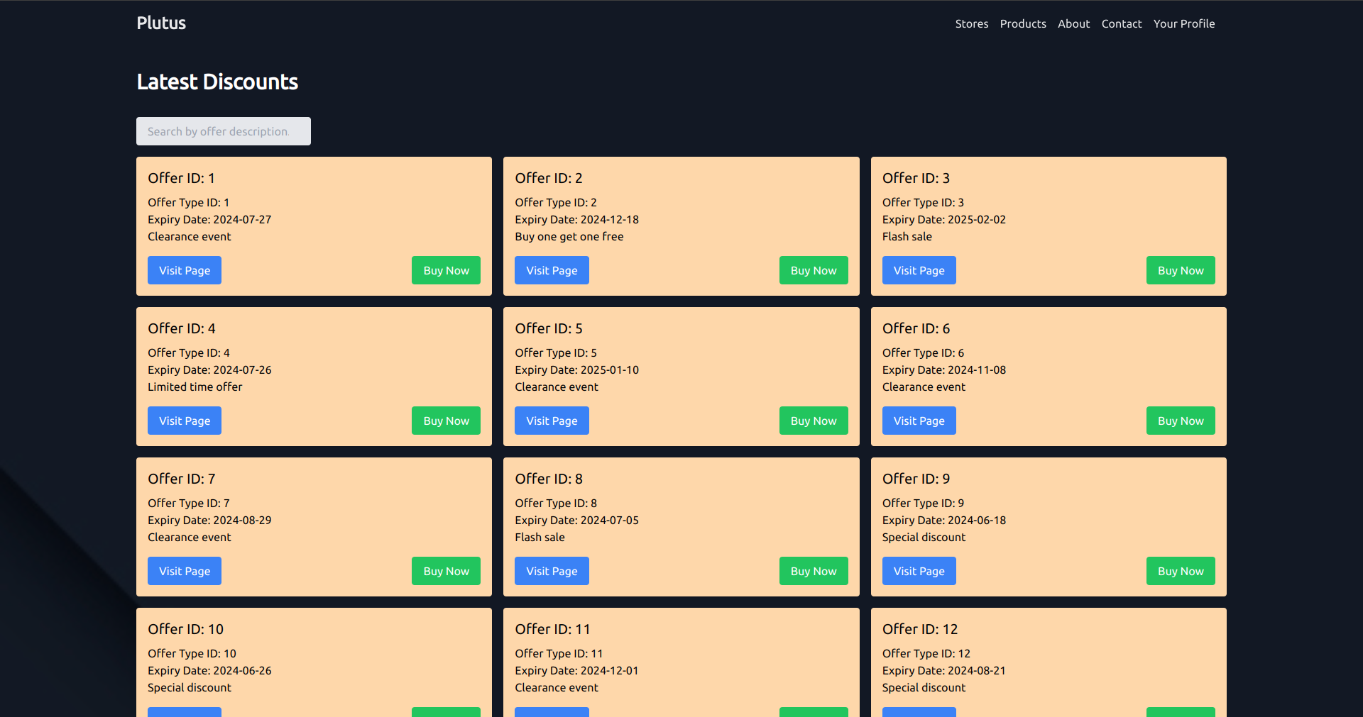
Live Demo

Slide 10
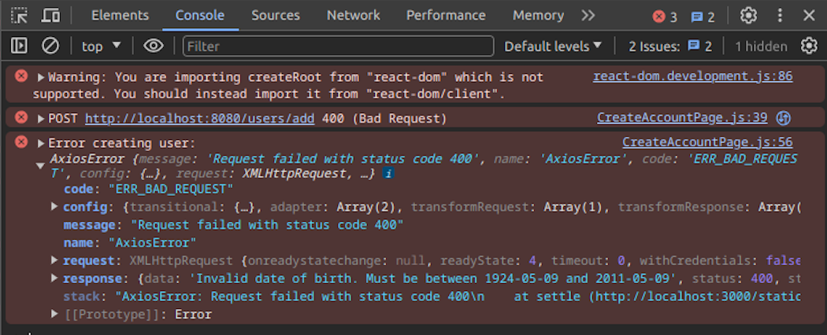
Challenges Encountered
Data Synchronization: Ensuring real-time synchronization between the frontend and backend was challenging due to the live nature of transaction processing.
Performance Optimization: Balancing system performance with high data volumes was critical, especially for real-time cashback notifications.
User Interface Responsiveness: Creating a responsive and intuitive user interface across different devices and platforms posed significant design challenges.
Technical Debt Management: Addressing accumulated technical debt while advancing project features and maintaining scalability.

Slide 11
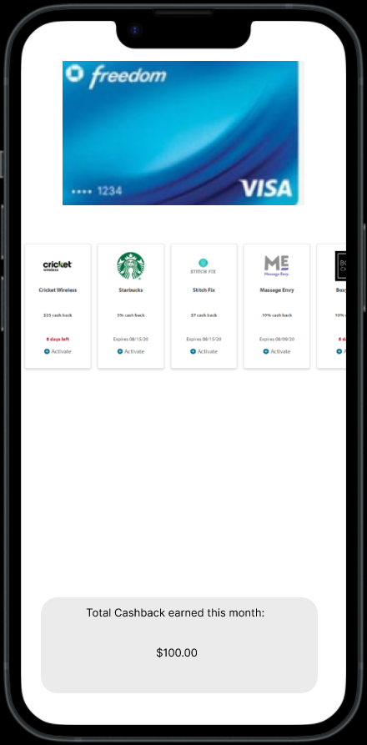
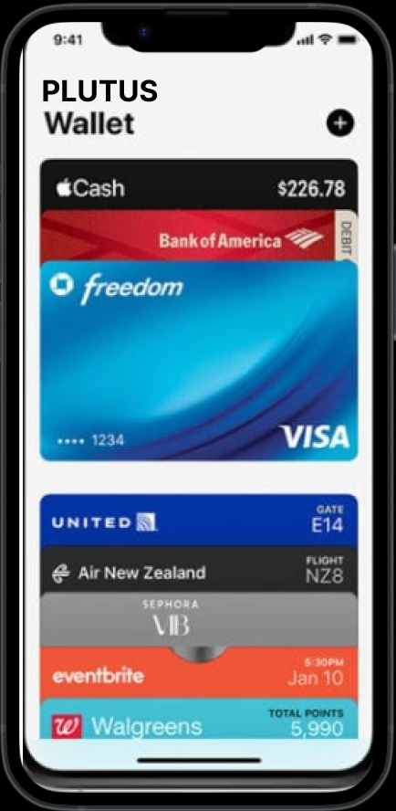
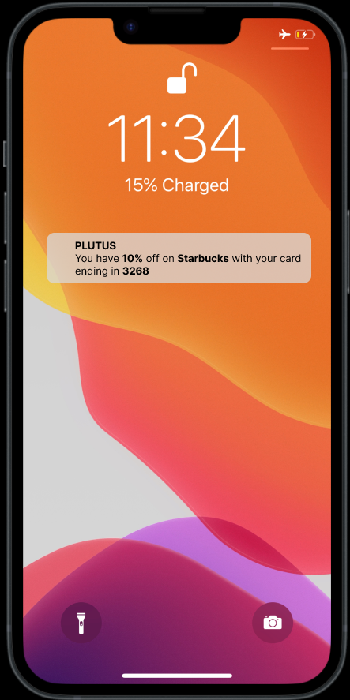
Future Plans
Enhanced Security Features: Implement additional layers of security protocols to safeguard user data even further.
User Interface Upgrades: Refine and enhance the user interface to support more intuitive navigation and interaction.
Mobile Application: Transitioning it into a comprehensive mobile application to enhance accessibility and convenience for users on-the-go

Slide 12
References
M. L. Black, D. Lambard, and X. Martinez-White, “Nearly 7 in 10 rewards credit cardholders sitting on unused cash back, points or miles,” LendingTree, Aug. 15, 2022. https://www.lendingtree.com/credit-cards/study/unused-rewards/.
A. McCann, “Number of credit cards and credit card holders in the U.S. (2024),” WalletHub, Feb. 16, 2024. https://wallethub.com/edu/cc/number-of-credit-cards/25532.

